Slide 1

Introduction to Cyber Security
Ritesh Dhanare
Assistant Professor
Information technology Department

Slide 2
Table of Contents
Secure programs
Non malicious Program Errors
Viruses
other malicious code
countermeasures

Slide 3
Secure programs
No faults
No unexpected behaviour

Slide 4
Secure programs
Types of flaws:
Validation error: permission check
Domain error: controlled access of data
Serialization and aliasing: Program flow order
Inadequate identification and authentication: Basis for authorization
Boundary condition violation: Failure on first or last case
Other exploitable logic error

Slide 5
Non malicious Program Errors
Buffer Overflow
Incomplete Mediation
Time to check to time of use errors

Slide 6
Buffer Overflow
Buffer overflows often come from innocent programmer oversights or failures to document and check for excessive data.
A buffer (or array or string) is a space in which data can be held. A buffer resides in memory. Because memory is finite, a buffer’s capacity is finite. For this reason, in many programming languages the programmer must declare the buffer’s maximum size so that the compiler can set aside that amount of space.

Slide 7
Buffer Overflow
char sample[10];
sample[10] = ‘B’;
sample[i] = ‘B’;
for (i=0; i<=9; i++)
sample[i] = ‘A’;
sample[10] = ‘B’

Slide 8
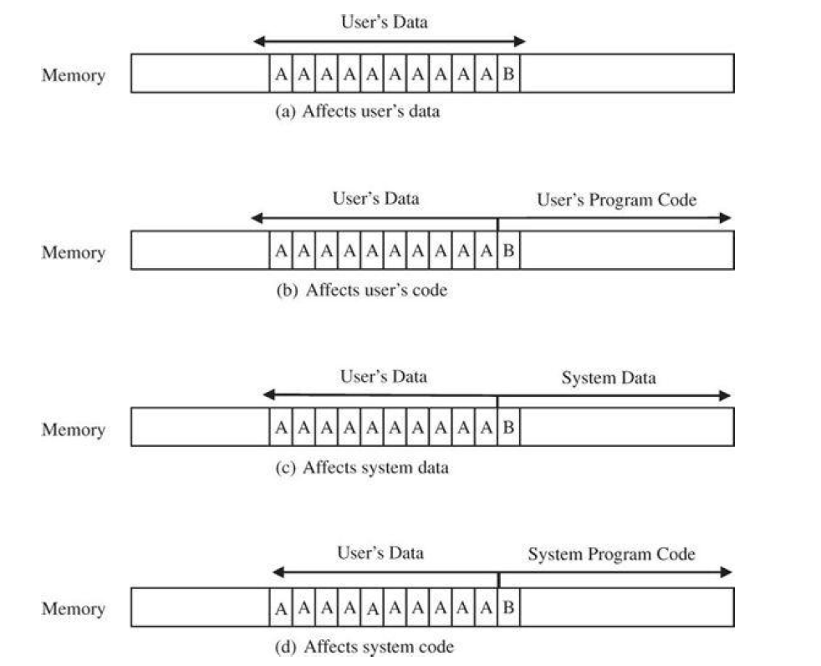
Buffer Overflow

Slide 9
Incomplete Mediation
Mediation means checking: the process of intervening to confirm an actor’s authorization before it takes an intended action.
Verifying that the subject is authorized to perform the operation on an object is called mediation.

Slide 10
Time-of-Check to Time-of-Use
The third programming flaw we describe also involves synchronization.
Between access check and use, data must be protected against change.

Slide 11
Viruses other malicious code
By themselves, programs are seldom security threats. The programs operate on data, taking action only when data and state changes trigger it. Much of the work done by a program is invisible to users who are not likely to be aware of any malicious activity.
For instance, when was the last time you saw a bit?
Do you know in what form a document file is stored?
If you know a document resides somewhere on a disk, can you find it?
Can you tell if a game program does anything in addition to its expected interaction with you?
Which files are modified by a word processor when you create a document?
Which programs execute when you start your computer or open a web page?

Slide 12
Why Worry About Malicious Code?
Malicious Code Can Do Much (Harm)
Malicious Code Has Been Around a Long Time

Slide 13
Kinds of Malicious Code
Malicious code or rogue program is the general name for unanticipated or undesired effects in programs or program parts, caused by an agent intent on damage.
This definition excludes unintentional errors, although they can also have a serious negative effect.
Definition also excludes coincidence, in which two benign programs combine for a negative effect.
The agent is the writer of the program or the person who causes its distribution.

Slide 14
Kinds of Malicious Code
A virus is a program that can replicate itself and pass on malicious code to other non-malicious programs by modifying them.
The term "virus" was coined because the affected program acts like a biological virus: It infects other healthy subjects by attaching itself to the program and either destroying it or coexisting with it.

Slide 15
Kinds of Malicious Code
A virus can be either transient or resident.
A transient virus has a life that depends on the life of its host; the virus runs when its attached program executes and terminates when its attached program ends. (During its execution, the transient virus may spread its infection to other programs.)
A resident virus locates itself in memory; then it can remain active or be activated as a stand-alone program, even after its attached program ends.

Slide 16
Kinds of Malicious Code
A Trojan horse is malicious code that, in addition to its primary effect, has a second, nonobvious malicious effect.
As an example of a computer Trojan horse, consider a login script that solicits a user's identification and password, passes the identification information on to the rest of the system for login processing, but also retains a copy of the information for later, malicious use.

Slide 17
Kinds of Malicious Code
A logic bomb is a class of malicious code that "detonates" or goes off when a specified condition occurs. A time bomb is a logic bomb whose trigger is a time or date.
A trapdoor or backdoor is a feature in a program by which someone can access the program other than by the obvious, direct call, perhaps with special privileges.
For instance, an automated bank teller program might allow anyone entering the number 990099 on the keypad to process the log of everyone's transactions at that machine.

Slide 18
Kinds of Malicious Code
A worm is a program that spreads copies of itself through a network. Shock and Hupp are apparently the first to describe a worm, which, interestingly, was for non-malicious purposes.
The primary difference between a worm and a virus is that a worm operates through networks, and a virus can spread through any medium.
Additionally, the worm spreads copies of itself as a stand-alone program, whereas the virus spreads copies of itself as a program that attaches to or embeds in other programs.

Slide 19
Kinds of Malicious Code
White et al. also define a rabbit as a virus or worm that self-replicates without bound, with the intention of exhausting some computing resource.
A rabbit might create copies of itself and store them on disk in an effort to completely fill the disk, for example.

Slide 20
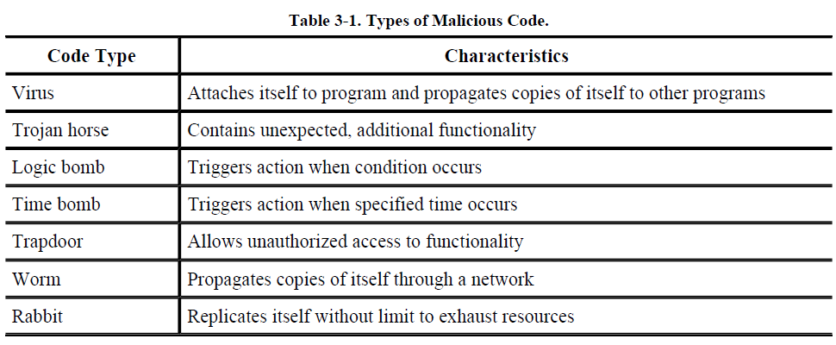
Kinds of Malicious Code

Slide 21
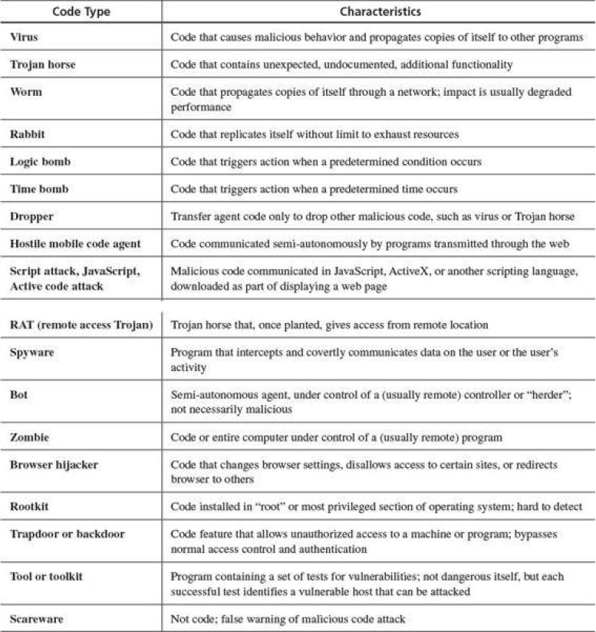

Slide 22
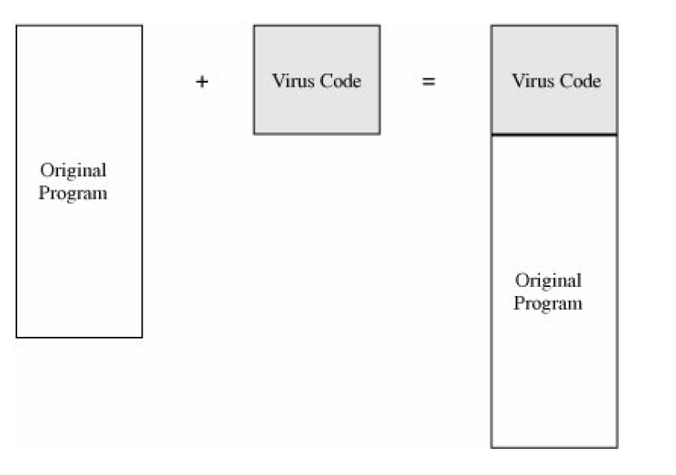
How Viruses Attach
Appended Viruses

Slide 23
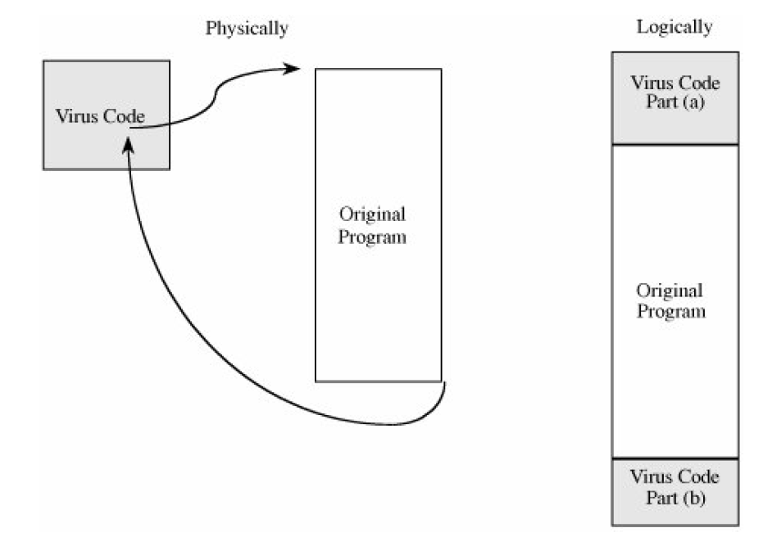
How Viruses Attach
Viruses That Surround a Program

Slide 24
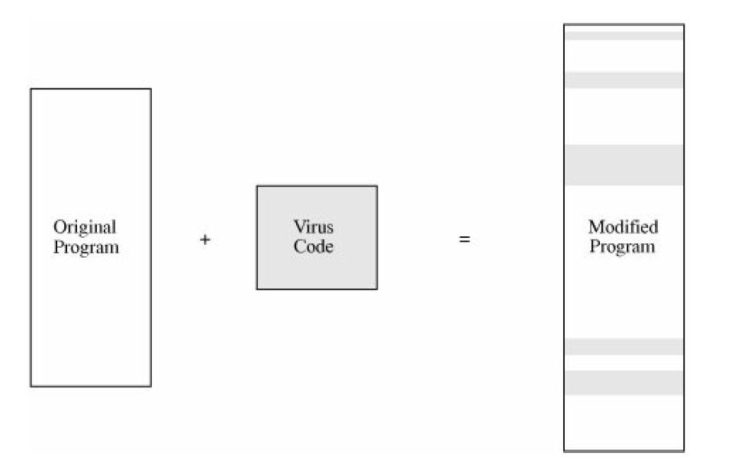
How Viruses Attach
Integrated Viruses and Replacements

Slide 25
How Viruses Attach
Integrated Viruses and Replacements

Slide 26
Document Viruses:
Currently, the most popular virus type is what we call the document virus, which is implemented within a formatted document, such as a written document, a database, a slide presentation, a picture, or a spreadsheet.
These documents are highly structured files that contain both data (words or numbers) and commands (such as formulas, formatting controls, links).
The commands are part of a rich programming language, including macros, variables and procedures, file accesses, and even system calls.

Slide 27
How Viruses Gain Control
The virus (V) has to be invoked instead of the target (T).
Essentially, the virus either has to seem to be T, saying effectively "I am T" or the virus has to push T out of the way and become a substitute for T, saying effectively "Call me instead of T.“
A more blatant virus can simply say "invoke me [you fool]."

Slide 28
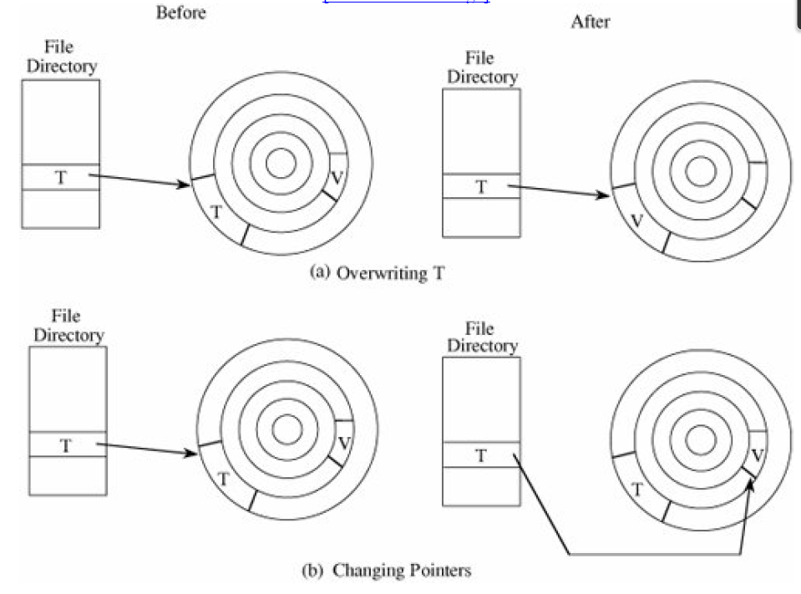
How Viruses Gain Control

Slide 29
The virus writer may find these qualities appealing in a virus:
It is hard to detect.
It is not easily destroyed or deactivated.
It spreads infection widely.
It can re-infect its home program or other programs.
It is easy to create.
It is machine independent and operating system independent.

Slide 30
Let us look more closely at the issue of viral residence.
One-Time Execution
The majority of viruses today execute only once, spreading their infection and causing their effect in that one execution.
A virus often arrives as an e-mail attachment of a document virus. It is executed just by being opened.

Slide 31
Boot Sector Viruses
A special case of virus attachment, but formerly a fairly popular one, is the so-called boot sector virus.
When a computer is started, control begins with firmware that determines which hardware components are present, tests them, and transfers control to an operating system.

Slide 32
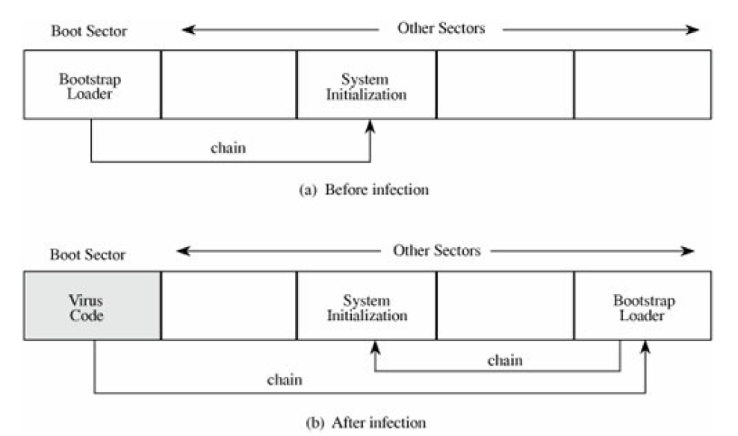

Slide 33
Memory-Resident Viruses

Slide 34
Virus Signatures
A virus cannot be completely invisible.
Code must be stored somewhere, and the code must be in memory to execute.
Moreover, the virus executes in a particular way, using certain methods to spread.
Each of these characteristics yields a telltale pattern, called a signature, that can be found by a program that looks for it.
The virus's signature is important for creating a program, called a virus scanner, that can detect and, in some cases, remove viruses.

Slide 35
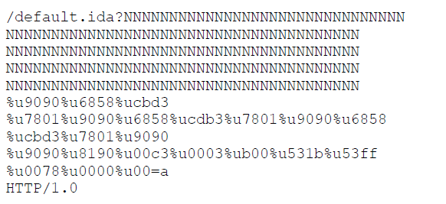
Virus Signatures

Slide 36
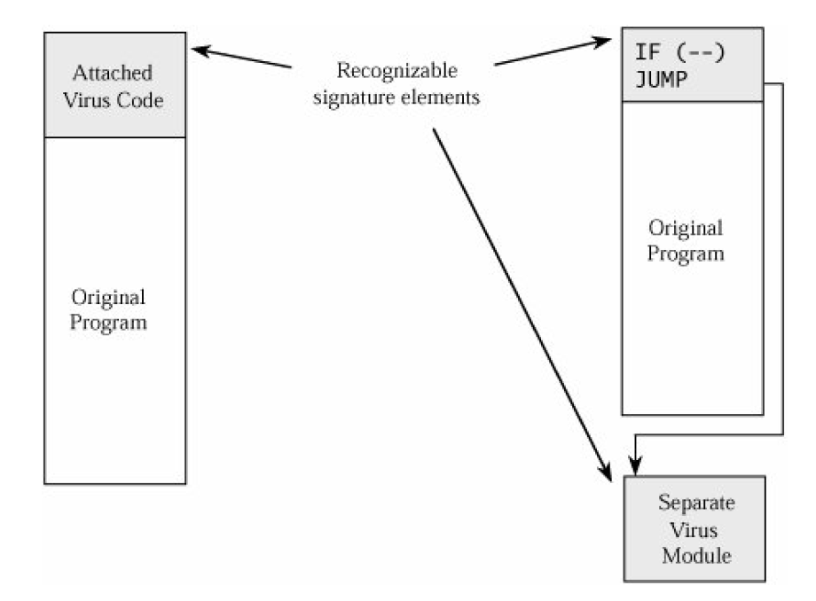
Storage Patterns

Slide 37
Execution Patterns
Transmission Patterns

Slide 38
Targeted Malicious Code
Trapdoors
Salami Attack
Rootkits
Privilege Escalation
Interface Illusions
Keystroke Logging
Man-in-the-Middle Attacks
Timing Attacks
Covert Channels: Programs That Leak Information
Notes:
A trapdoor is an undocumented entry point to a module. Developers insert trapdoors during code development, perhaps to test the module,
to provide "hooks" by which to connect future modifications or enhancements, or to allow access if the module should fail in the future. In
addition to these legitimate uses, trapdoors can allow a programmer access to a program once it is placed in production.
The classic tale of a salami attack involves interest computation. Suppose your bank pays 6.5 percent interest on your account. The interest
is declared on an annual basis but is calculated monthly. If, after the first month, your bank balance is $102.87, the bank can calculate the
interest in the following way. For a month with 31 days, we divide the interest rate by 365 to get the daily rate, and then multiply it by 31 to
get the interest for the month. Thus, the total interest for 31 days is 31/365*0.065*102.87 = $0.5495726. Since banks deal only in full cents,
a typical practice is to round down if a residue is less than half a cent, and round up if a residue is half a cent or more. However, few people
check their interest computation closely, and fewer still would complain about having the amount $0.5495 rounded down to $0.54, instead
of up to $0.55. Most programs that perform computations on currency recognize that because of rounding, a sum of individual
computations may be a few cents different from the computation applied to the sum of the balances.
A later variation on the virus theme is the rootkit. A rootkit is a piece of malicious code that goes to great lengths not to be discovered or,
if discovered and removed, to reestablish itself whenever possible. The name rootkit refers to the code's attempt to operate as root, the
superprivileged user of a Unix system.
Programs run in a context: Their access rights and privileges are controlled by that context. Most programs run in the context of the
invoking user. If system access rights are set up correctly, you can create, modify, or delete items you own, but critical system objects are
protected by being outside your context. Malicious code writers want to be able to access not just your objects but those outside your
context as well. To do this, the malicious code has to run with privileges higher than you have. A privilege escalation attack is a means for
malicious code to be launched by a user with lower privileges but run with higher privileges.
The name for this attack is borrowed from Elias Levy. An interface illusion is a spoofing attack in which all or part of a web
page is false. The object of the attacker is to convince the user to do something inappropriate, for example, to enter personal banking information on a site that is not the bank's, to click yes on a button that actually means no, or simply to scroll the screen to activate an event
that causes malicious software to be installed on the victim's machine. Levy's excellent article gives other excellent examples.
Remember the movies in which a detective would spy a note pad on a desk, hold it up to the light, and read the faint impression of a
message that had been written and then torn off that pad? There is a computer counterpart of that tactic, too.
A man-in-the-middle attack is one in which a malicious program interjects itself between two other programs, typically between a user's
input and an application's result. One example of a man-in-the-middle attack could be a program that operated between your word
processor and the file system, so that each time you thought you were saving your file, the middle program prevented that, or scrambled
your text or encrypted your file.
So far, we have looked at malicious code that performs unwelcome actions. Next, we turn to programs that communicate information to
people who should not receive it. The communication travels unnoticed, accompanying other, perfectly proper, communications. The
general name for these extraordinary paths of communication is covert channels. The concept of a covert channel comes from a paper by
Lampson [LAM73]; Millen [MIL88] presents a good taxonomy of covert channels.

Slide 39
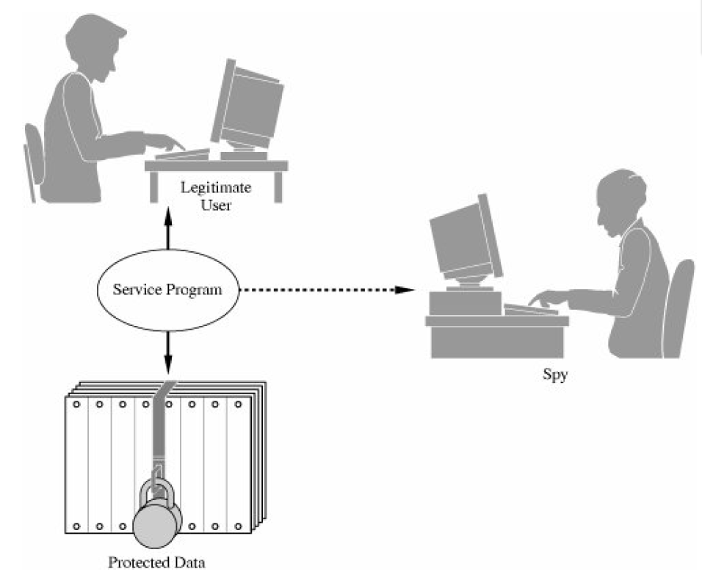

Slide 40
Controls Against Program Threats
Developmental Controls
The Nature of Software Development
Modularity, Encapsulation, and Information Hiding
Mutual Suspicion
Confinement
Genetic Diversity
Peer Reviews
Hazard Analysis
Testing

Slide 41
Controls Against Program Threats
Good Design
Prediction
Static Analysis
Configuration Management
Lessons from Mistakes
Proofs of Program Correctness
Programming Practice Conclusions
Standards of Program Development

